Slide 1
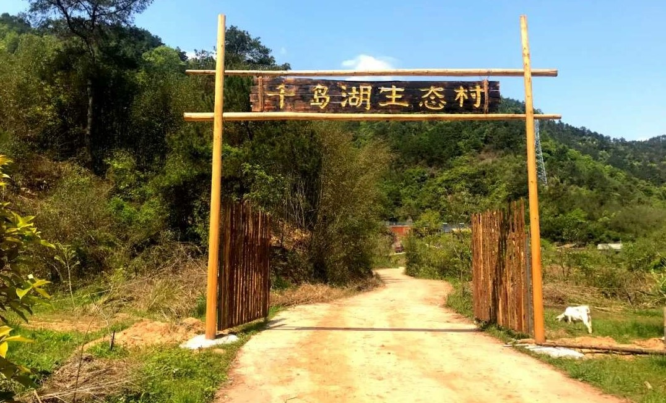
Qiandaohu Ecovillage

Slide 2

THE VISION: The return of mankind to unity and unison with nature. Creation of a Paradise on Earth - A self sufficient and sustainable way of living in a heavenly Ecovillage.
THE MISSION: To unveil to mankind the reality that people and nature are one community of shared life on Earth. To promote and make known worldwide, ways of agriculture and lifestyle which will allow perfect integration of mankind and nature.
CORE VALUES: A community of shared life on Earth

Slide 3
. Introduction of Ecovillage
. What do we do in the Ecovillage?
. A Dao Ecovillage – Noah’s Ark of Mankind in the future

Slide 4

Introduction of Ecovillage
Qiandaohu Biospheral Education and Promotion Center (Referred as Ecovillage in short) is a critical branch of the Dao Nature Reserve Centre. The Ecovillage is situated on a hill in a town called Jiangjiazhen, at the south west of Qiandaohu District.
The Ecovillage is a non-profit making community center, focusing on education and implementation of natural farming, with the final aim in producing Zero waste and Zero pollution, in support of a kind of Eco lifestyle that enables harmonious co-existence of mankind and nature. Since its formation in 2014, the center has been on the run in organizing various public welfare courses pertaining to biospheral farming, as well as courses in support of eco-lifestyle that leads to zero waste and zero pollution.

Slide 5
Introduction of Ecovillage
In a short span of 5 years since its inception, the center has attracted enthusiasts in spiritual development and environmental protection from all over the country and the world.
At present, there are nearly 30 long-term volunteers serving the center. These young enthusiasts care about the world, they are keen on spiritual transformation, and aspired to protect the Earth. Here, they learn about some exemplary traditional culture of the ancestors; they get to apply in practice what they learn about natural farming; they take into reality the ways of life which enable mankind to co-exist harmoniously with the environment, reverting to basic and simple lifestyle, but at the same time, making their strides towards expanding their morality and intellectual ability to steer the society, nation and the world towards a more meaningful direction.

Slide 6
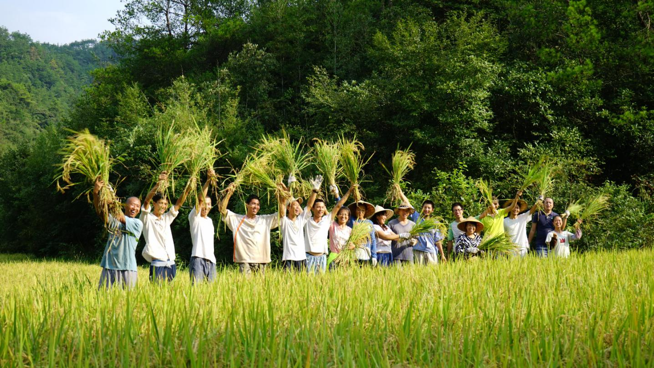

Slide 7
1. Learning the Wisdom of Nature
Half of the time in the Ecovillage is spent on courses about boundless inner self and morality development, to get to know about our parents of the Universe, to understand the indisputable truth that man and nature is a community of shared life on Earth, to broaden one’s mindset to internalize nature in their thoughts, to be emotionally and spiritually prepared in serving mankind.
What do we do in the Ecovillage?

Slide 8
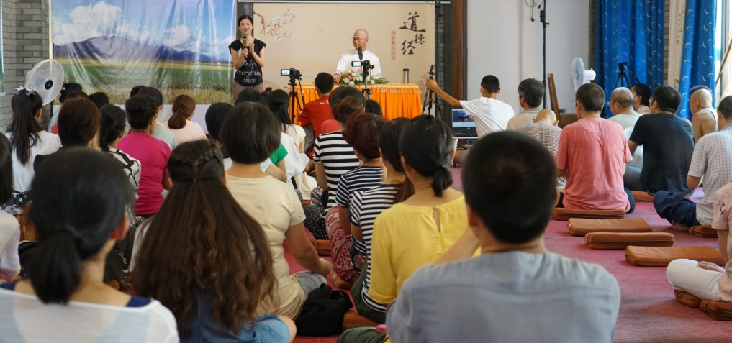
Learning the Wisdom of Nature

Slide 9
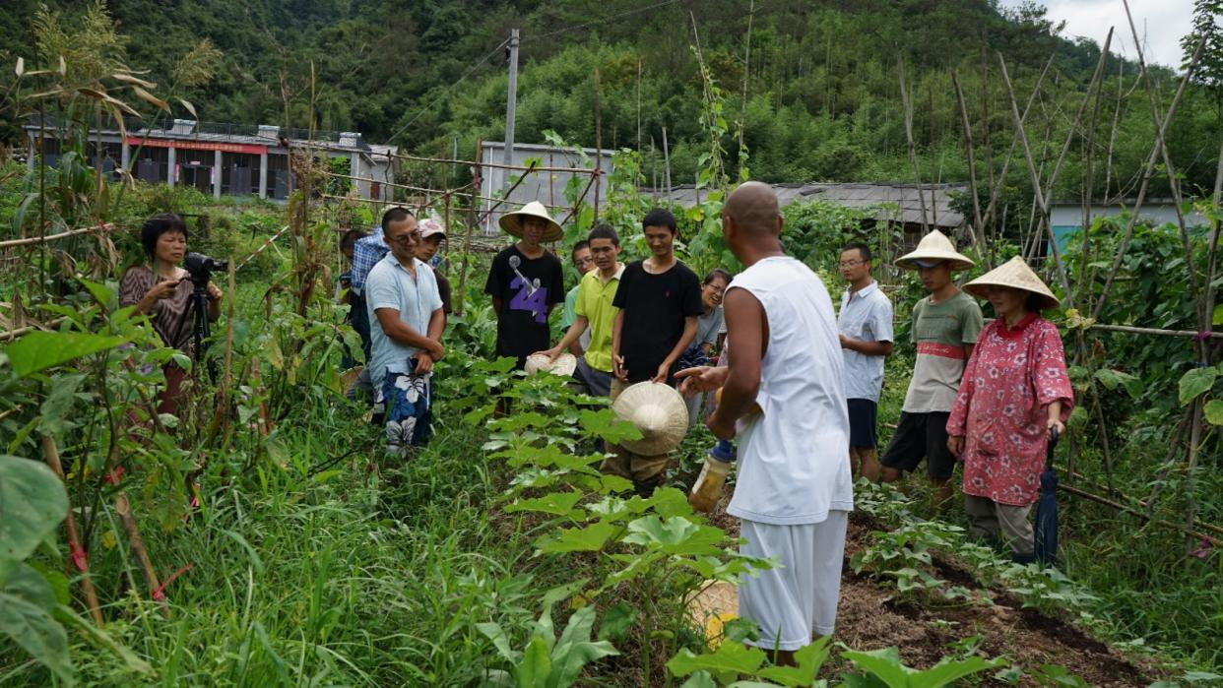
2.Practising natural farming
What do we do in the Ecovillage?
Every volunteer is given a parcel of land so that they could fully implement what they learn, and share their learnings regularly.

Slide 10
3. Practising lifestyle of
zero waste zero pollution
The Ecovillage is practicing a life that tends to zero waste and zero pollution. By now, all one-off disposable household items (toilet paper, sanitary napkins, etc.) are avoided, chemical based cleaning supplies and skincare products are no longer used. (home-made cleaning supplies, Handmade soap, toothpaste etc .)
What do we do in the Ecovillage?

Slide 11
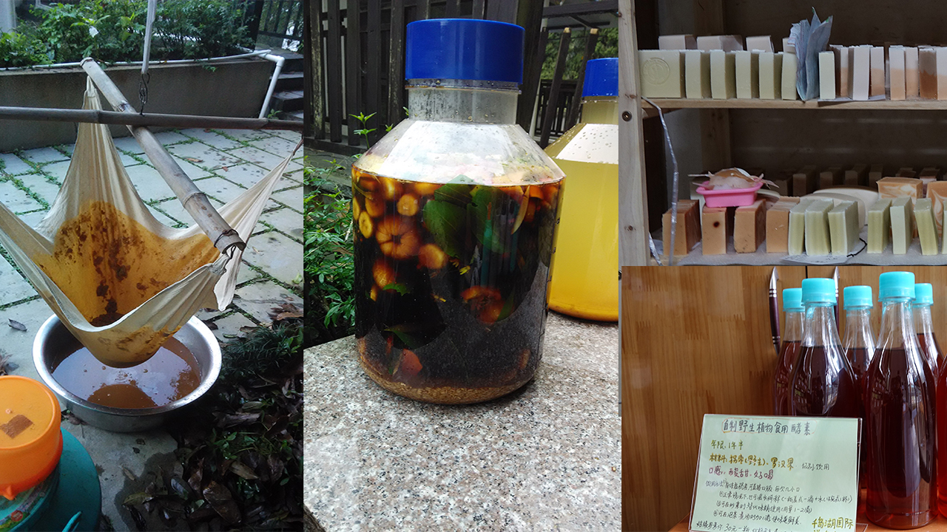
lifestyle of zero waste zero pollution

Slide 12
4. Experiencing lifestyle which is
in unity and unison with Nature, and
enjoying the corresponding abundance
What do we do in the Ecovillage?
Living a life in harmony with nature is a very critical curriculum practised in the Ecovillage. Dwellers manage to create products and supplies in abundance by just utilising local material and resources: food and grains, vegetables, daily products, and other natural products.

Slide 13
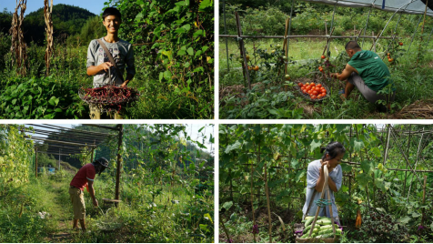
A abdundant and happy life in the Ecovillage

Slide 14
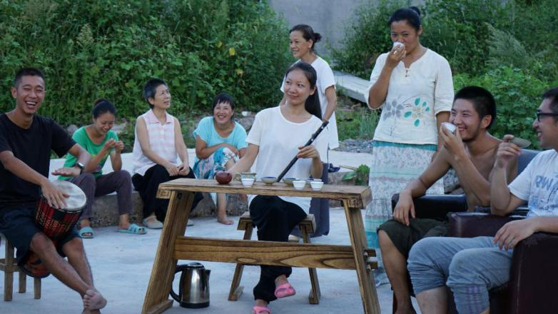
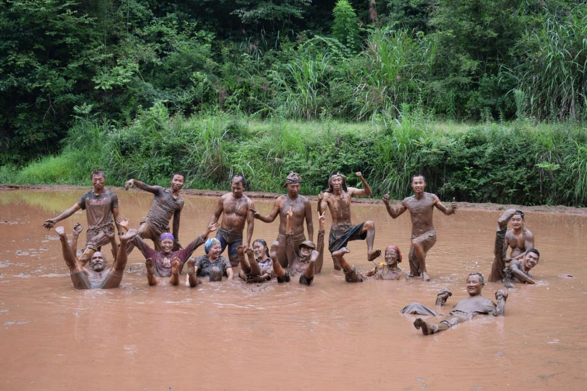
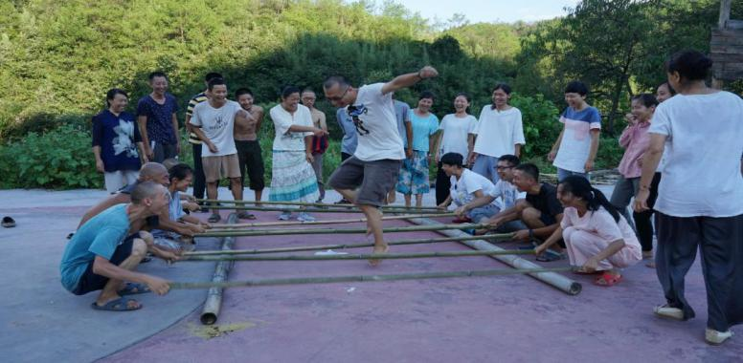
5.To lead an artistic and artisanal lifestyle
What do we do in the Ecovillage?

Slide 15
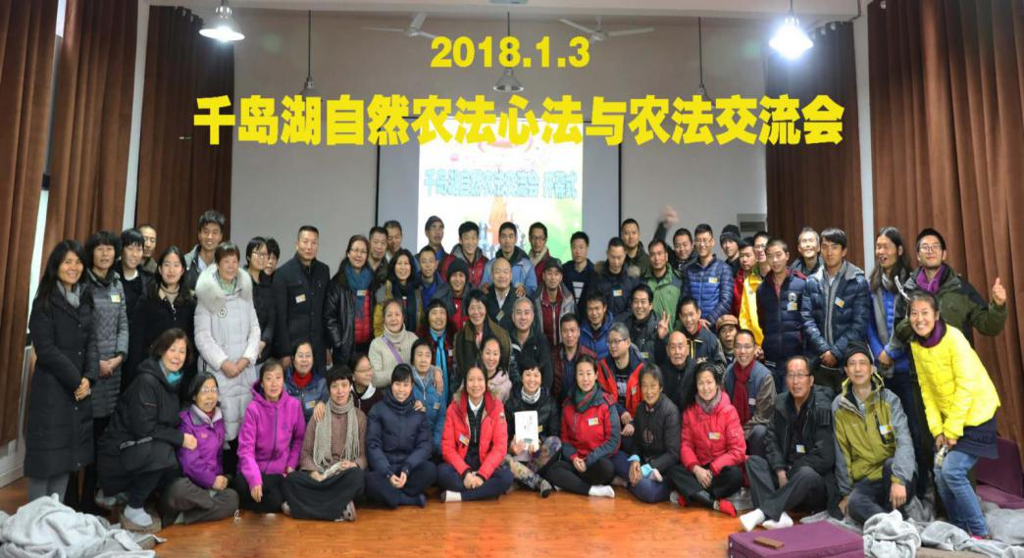
B. Serving the Society
Exchange of the way of Dao applied to biospheral farming in Ecovillage

Slide 16
1. Continuous organisation of Natural Farming classes
The Ecovillage conducts non-stop courses on biospheral farming. This course is an amalgamation of quintessence of Dao De Jing, natural farming, and principles of sustainability into practice. The Natural Farming Camp has been attended by students from various parts of China, as well as from Germany, Malaysia, Macau, Hong Kong, Taiwan, Vietnam etc.
Serving the Society

Slide 17
2. Continuous organisation of sustainable living course, to make popular the way of eco-lifestyle to enable unity and unison of man with nature
Every month, the center manages reception of numerous domestic and foreign visitors. These visitors get to live in an environmentally friendly lifestyle that is totally free from disposal household products and chemical detergents. By now some 5,000 visitors have gained experience in natural farming and lived a lifestlye in total harmony with nature, which supports sustainability by generating zero waste zero pollution.
Serving the Society

Slide 18
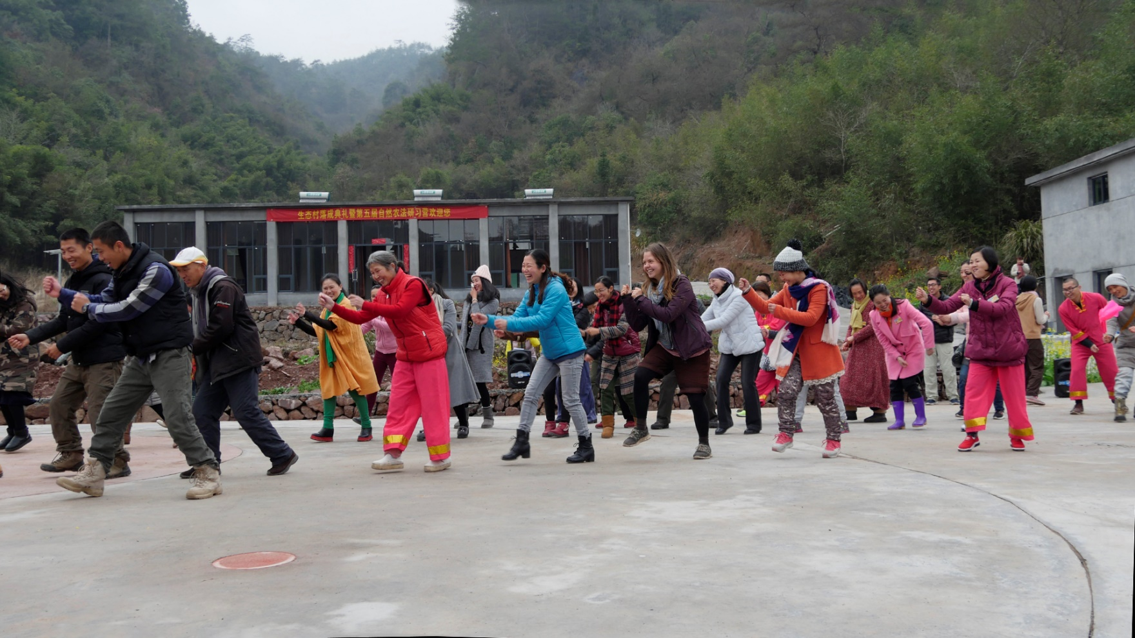
3. Play an active role
in communication and interaction as well as
engaging in international exchanges pertaining to
the design and construction of Dao Ecovillages
Serving the Society

Slide 19
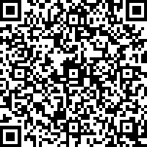


A Dao Ecovillage
Noah’s Ark of Mankind in the future
A lifestyle basing on the way of Dao (Dao is another name of Universe.), where men and nature co-exist in unity and unison, where All beings will be inspired and guided by nature accordingly, is the ultimate ideal lifestyle that mankind would yearn for. This is also the perfect lifestyle touted by various sages since 2,500 years. The way of Dao could serve as the bedrock of which beautiful sustainable villages could be built all over the world, that every country could become strong, civilized, modern, democratic, blessed with abundance and harmony. Perfect co-existence between Mankind and Nature is the only way to guarantee perpetual prosperity and the development of Earth.

